Slide 1
Quality Enhancement for Drone Based Video
GUIDE:
Dr. S Vasavi
Professor
Vedavyas Yarraguntla-188W1A05B5
Sri Harsha Seelamneni-188W1A05B6
Sai Subhash Manam-188W1A05B7

Slide 2


Abstract
Nowadays Drones are being widely used for surveillance and various other activities. The video stream produced by the drone can be disturbing or can contain noise data which might reduce the quality of the video stream. The video stream can be enhanced so that there is no disturbance in the video stream. The video enhancement can be done in real-time with the help of FPGA which reduces the processing time with low energy consumption. Our project mainly focuses on enhancing the quality of the video stream by integrating the image source in the drone with the FPGA.
Keywords:- Image Processing, Quality Enhancement, FPGA, Drone Video

Slide 3
Problem Statement
Today Surveillance is done using the drones, The images or the videos which are collected from the drones may contain the disturbances due to the camera which is attached or due to the network issues so the video stream which is produced by the drone needs to be enhanced before it can be used for any purpose.

Slide 4

objective
The objective of the project is to enhance the quality of the video stream and reduce the noise in the stream produced by the drone.
scope
This project uses video recorded by drones and can be used for security surveillance for the places where human cannot go

Slide 5
Basic concepts
Image enhancement techniques
CNN(GAN)
FPGA

Slide 6
Image enhancement techniques
CLAHE : Contrast Limited Adaptive Histogram Equalization (CLAHE) is a variant of Adaptive histogram equalization (AHE) which takes care of over-amplification of the contrast. CLAHE operates on small regions in the image, called tiles, rather than the entire image
Gamma correction: controls the overall brightness of an image. Images which are not properly corrected can look either bleached out, or too dark. ... Varying the amount of gamma correction changes not only the brightness, but also the ratios of red to green to blue.
Color Saturation Adjustment: the Method associates with the correlation of light brightness and color saturation that was found by the simulation of light over exposure. When the light brightness varies, the color saturation also changes accordingly. The changes of luminance and color saturation are corresponded to the YCbCr color model.

Slide 7
Cnn(gan)
A Convolutional Neural Network (ConvNet/CNN) is a Deep Learning algorithm which can take in an input image, assign importance (learnable weights and biases) to various aspects/objects in the image and be able to differentiate one from the other. A generative adversarial network (GAN) is a machine learning (ML) model in which two neural networks compete with each other to become more accurate in their predictions. GANs typically run unsupervised and use a cooperative zero-sum game framework to learn.

Slide 8
fpga
Field Programmable Gate Array is an integrated circuit that can be programmed by a user for a specific use after it has been manufactured. FPGAs consist of logical modules connected by routing channels. Each module is made up of a programmable lookup table that is used to control the elements that each cell consists of and to perform logical functions of the elements that make up the cell. FPGAs are mainly used to design application-specific integrated circuits (ASICs)

Slide 9
Literature survey

Slide 10
[1]A real-time video de fogging algorithm
International Conference on Display Technology(2020)
They proposed a fast and efficient real-time video de fogging algorithm based on pyramid model, which solves the problems existing in the defogging algorithms, such as over-estimation of transmittance, color distortion of sky area, and poor real-time performance. Pyramid subsampling is used to obtain reduced images. The coarse transmittance of the reduced image is obtained by introducing pseudo-defogging image and the confidence of dark primary color as correction factors. The image was returned to the original size, and the texture was refined with the combined bilateral filtering. Finally, the atmospheric light scattering model and the inter-frame video defogging theory were combined to restore the degraded video.

Slide 11
Advantages
The proposed method has a complete defogging effect and can efficiently defog a variety of scenes.
It is fast and stable in operation.
Disadvantages
The algorithm still needs to be improved in terms of the processing speed for degraded video with resolution of 1080P.
The refining process of its coarse transmittance still needs to be improved.

Slide 12
[2]Image Enhancement using Fuzzy Intensity Measure and Adaptive Clipping Histogram Equalization
IAENG International Journal of Computer Science(2019).
Generally, histogram equalization is widely used in image enhancement due to its simplicity and effectiveness; it changes the mean brightness of the enhanced image and introduces a high level of noise and distortion. So, to reduce the noise and the distortion they used fuzzy intensity measure and adaptive clipping histogram equalization. It uses fuzzy intensity measure to first segment the histogram of the original image, and then clip the histogram adaptively in order to prevent excessive image enhancement. they conducted experiments on the Berkeley database and CVF-UGR-Image database to show that proposed model is more efficient histogram equalization-based methods.

Slide 13
Advantages
It reduces the noise and distortion caused by the histogram equalization.
It is more effective than any other histogram equalization.
Disadvantages
Adaptive histogram equalization method has the tendency to over-amplify noise in relatively homogeneous regions of an image.

Slide 14
[3]Video surveillance image enhancement via a convolutional neural network and stacked denoising autoencoder.
Neural Computing & Applications Springer Nature(2021)
They developed a deep learning image enhancement model which will enhances and reduce the noise in the image. The model consists of two deep learning blocks first block will enhance the image and second block is used to reduce the noise in the image using the stacking denoising autoencoder which consists of three denoising autoencoder layers which helps to enhance the contrast and rescue the noise. Both the deep learning models work parallelly and produces high resolution and noise reduced images. the output of both images are fused using Wavelet fusion.

Slide 15
Advantages
The low-resolution images are converted to high resolution images.
The noise in the image is also eliminated.
Disadvantages
The training of autoencoder requires lots of data and processing time.
The autoencoder is more sensitive to input errors present in the training set.

Slide 16
[4]An FPGA Based Residual Recurrent Neural Network for Real-Time Video Super-Resolution.
IEEE Transactions on Circuits and Systems for Video Technology(2021)
The proposed hardware-efficient VSR model ERVSR is built on the residual recurrent convolutional neural network. The hidden state is propagated forward along the temporal dimension. Combining the LR frame with the recurrent input which conveys the temporal information of previous frames, ERVSR reconstructs the HR frame along with the associated hidden state. Specially, residual learning is employed to improve the learning efficiency and prevent from gradient vanishing. Firstly, the model parameters are loaded from the register buffer. The RGB pixels are converted to YCbCr ones. To perform 3×3 convolution for the Y channel, two-line buffers combining with the input stream.

Slide 17
Advantages
less memory
light weight architecture
real-time.
Disadvantages
without self-initiation, the recurrent network performs slightly worse than the non-recurrent creating additional load on hardware.

Slide 18
[5]Proficient Technique for Satellite Image Enhancement Using Hybrid Transformation with FPGA.
International Conference on Advances in Electrical, Computing, Communication and Sustainable Technologies (ICAECT)(2021)
A new approach was proposed, which improves the picture of the satellite using the SVD DWT concept, the Gaussian transformation DWT and multiwavelet transformation. This suggested approach would convert and approximate the single-color value matrix of the low-flowing sub-band into one low-frequency and 15 high-frequency sub-bands, and then recreate the improved picture using the inverse transformation.Spartan-3E is chosen as FPGA.

Slide 19
Advantages
high quality contrast
reduced noise in image
real-time
smoother edges
Disadvantages
low signal to noise ratio

Slide 20
[6]Implementation of an FPGA Real-Time Configurable System for Enhancement of Lung and Heart Images
Springer Nature Switzerland AG 2021
The process will first start by reshaping the given image to a binary sequence. Since any hardware device can only work on binary values, the image layers are converted into binary sequence. Various image processing techniques were used like noise reduction, image enhancement, and image restoration. Each image pixel is represented by an 8-bit × 3 RGB values. The entire image is then converted to a sequence of pixels that can be accessed by its row and column values and the method of parallelism enables faster functioning and faster performance.

Slide 21
Advantages
faster performance
real-time
highlight portions of images.
Disadvantages
more memory is required
high power consumption.

Slide 22
[7]A Low-Cost and High-Throughput FPGA Implementation of the Retinex Algorithm for Real-Time Video Enhancement.
IEEE Transactions on Very Large-Scale Integration (VLSI) Systems(2020).
In this paper, instead of the traditional retinex algorithm, a low cost and high throughput design of retinex algorithm is implemented for quality enhancement of real-time video stream. Using FPGA, they achieved a throughput of 60 frames/sec for a 1920*1080 image with low latency which can be considered as negligible (0.2 MS). This whole procedure is categorized into seven modules, where each module processes the image enhancement algorithm for the real time video stream.

Slide 23
Advantages
This technique is cost friendly and comparatively less complex to implement.
High throughput can be achieved with negligible latency.
Disadvantages
Proper clock frequency should be maintained to obtain the desired throughput while avoiding unnecessary power consumption.

Slide 24
[8]FPGA-Based Low-Visibility Enhancement Accelerator for Video Sequence by Adaptive Histogram Equalization With Dynamic Clip-Threshold
IEEE Transactions on Very Large Scale Integration (VLSI) Systems(2020).
In this paper, adaptive histogram equalization with dynamic clip-threshold (AHEwDC) technique is followed for achieving high performance in real-time. They implemented this using FPGA for enhancing low visibility areas of the video sequence. To overcome the noise amplification in the video they proposed a visibility assessment model for achieving best video clip threshold. Intel Cyclone V FPGA hardware was used for implementation. The hardware they described can process 30fps full HD video at a threshold frequency of 75.84 MHz A comparison was made with actual images and enhanced images with different AHEwDC thresholds and optimized clip threshold gave the best enhanced result of the input stream for all inputs.

Slide 25
Advantages
Different clip thresholds give different levels of enhancement according to the requirement.
Support Full HD video enhancement in real-time.
Disadvantages
Maximum working frequency of FPGA is 75.84MHz.

Slide 26
[9]Image Quality Assessment Based on Deep Learning with FPGA Implementation
Springer signal processing : Image communication 83
In this paper, a novel image quality assessment (IQA) algorithm was proposed that rely on an optimized version of convolutional neural network architecture design. This was introduced for the extraction of certain image quality features that are discriminative in the image automatically. For further improvement of the learning ability of the designed CNN model, advanced features like local luminance coefficient normalization were used. The algorithm designed finally implemented using FPGA on two public databases. The notable thing was it outperformed in terms of speed and accuracy compared to many IQA algorithms.

Slide 27
Advantages
Modified CNN model increased speed and accuracy.
Optimized caching design was used for speeding operation rate.
Disadvantages
Performance reduced when number of convolutional kernels exceeds 40.

Slide 28
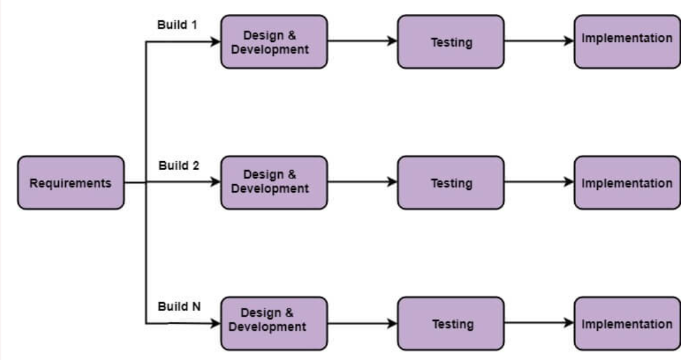
Software engineering model (Incremental waterfall model)[10]

Slide 29
Incremental waterfall model
Incremental Model is a process of software development where requirements divided into multiple standalone modules of the software development cycle. In this model, each module goes through the requirements, design, implementation and testing phases. Every subsequent release of the module adds function to the previous release. The process continues until the complete system achieved
WHY?
Simple to use.
Uses an iterative approach which suits our implementation model.

Slide 30
Software Requirements
Cv2
Numpy
Pil
Hardware Requirements
Drone
FPGA
Tensor Flow

Slide 31
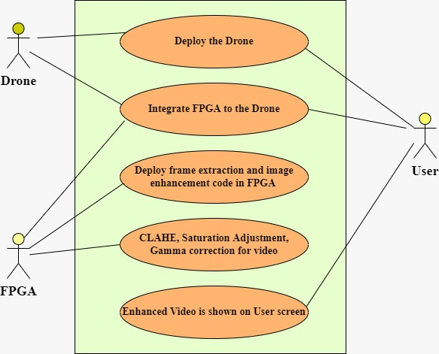
Use Case Diagram

Slide 32
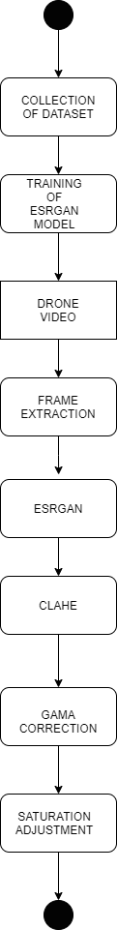

Activity diagram

Slide 33
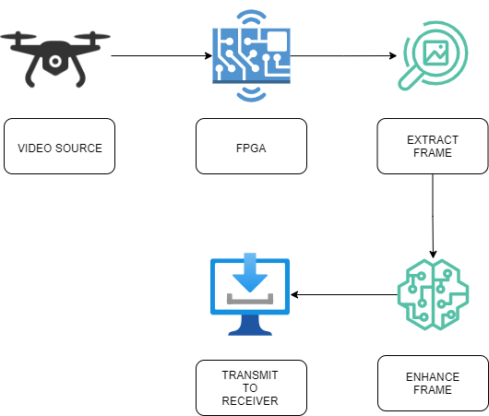
System architecture

Slide 34
Dataset
UG2 Dataset consists of videos collected from UAV, Glider, and Ground videos. It consists of 684 videos. It was published in IEEE Winter Conference on Applications of Computer Vision 2018.
UAV Dataset consists of videos collected from different UAV's. It consists of 50 video sequences of 70250 frames with 30 fps frame rate.

Slide 35
Modules
Drone Video enhancement
FPGA implementation of Image Enhancement
Integration of Drone & FPGA

Slide 36
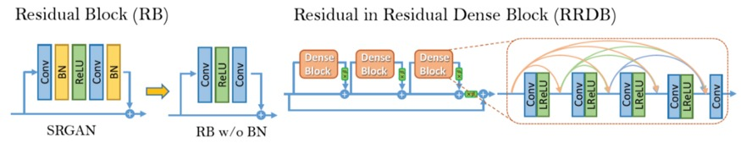
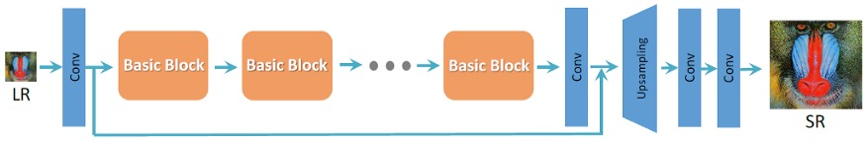
methodology
we propose a model which will enhance the image/frame.
Initially the image/frame is sent to ESRGAN model which we trained for enhancing the image.
Then the image/frame is sent to the Contrast Limiting Adaptive Histogram Equalization(CLAHE) which will increases the contrast of the image using histogram equalization.
Then the image/frame is sent for gamma correction which reduces the artifact and improves the lightning of the image.
Then the image/frame will be sent to the saturation adjustment which will be helpful for increasing the saturation of the image.

Slide 37
references
1.A real-time video de fogging algorithm, Lu Di, Yan Limin, International Conference on Display Technology(2020).
2.Image Enhancement using Fuzzy Intensity Measure and Adaptive Clipping Histogram Equalization, Xiangyuan Zhu, Xiaoming Xiao, Tardi Tjahjadi, Zhihu Wu, Jin Tang, IAENG International Journal of Computer Science(2019).
3.Video surveillance image enhancement via a convolutional neural network and stacked denoising autoencoder, Muhamad Faris Che Aminudin, Shahrel Azmin Suandi, Neural Computing & Applications Springer Nature(2021).
4.An FPGA Based Residual Recurrent Neural Network for Real-Time Video Super-Resolution, Kaicong Sun, Maurice Koch, Zhe Wang, Slavisa Jovanovic, Sven Simon IEEE Transactions on Circuits and Systems for Video Technology(2021).
5.Proficient Technique for Satellite Image Enhancement Using Hybrid Transformation with FPGA, B.Paulchamy, S.Chidambaram, J.Jaya ,International Conference on Advances in Electrical, Computing, Communication and Sustainable Technologies (ICAECT)(2021).
6.Implementation of an FPGA Real-Time Configurable System for Enhancement of Lung and Heart Images , K.B.Sowmya, T.S.Rakshak Udupa, and Shashank K.Holla (2020).

Slide 38
7.A Low-Cost and High-Throughput FPGA Implementation of the Retinex Algorithm for Real-Time Video Enhancement, Jin Woo Park, Hyokeun Lee, Boyeal Kim, Dong-Goo Kang, Seung Oh Jin, Hyun Kim, Hyuk-Jae Lee, IEEE Transactions on Very Large Scale Integration (VLSI) Systems(2020).
8.FPGA-Based Low-Visibility Enhancement Accelerator for Video Sequence by Adaptive Histogram Equalization With Dynamic Clip-Threshold, Canran Xu, Zizhao Peng, Xuanzhen Hu, Wei Zhang, Lei Chen, and Fengwei An, IEEE Transactions on Circuits and Systems I: Regular Papers (2020).
9.Image Quality Assessment Based on Deep Learning with FPGA Implementation,Min-ling Zhu, Dong-yuan Ge (2020).
10. Incremental Model (Software Engineering) - javatpoint. (2019, August). www.Javatpoint.Com. https://www.javatpoint.com/software-engineering-incremental-model

Slide 39

THANK YOU

